Slide 1
Basics of Set Theory

Slide 2
Course Material
Set Theory
Basics
Counting/Combinatorics
Probability/Statistics
Functions
Logic
Logic
Proof Techniques
Math
Sequences and Series
Asymptotic Analysis
Matrix Math
Modular Arithmetic
Graph Theory
Basics
Finite Automata and Language Theory

Slide 3
Why Sets?
Foundational
Counting, Statistics, Graph Theory, Networking, Algorithms

Slide 4
Vocabulary List
Set
Element
Subset
Power set
Two sets are equal if they contain the same elements (and only the same elements)
Cartesian product
Finite set
Infinite set
Union
Intersection
Disjoint
Difference
Complement
*Symmetric difference (don’t need to know)

Slide 5
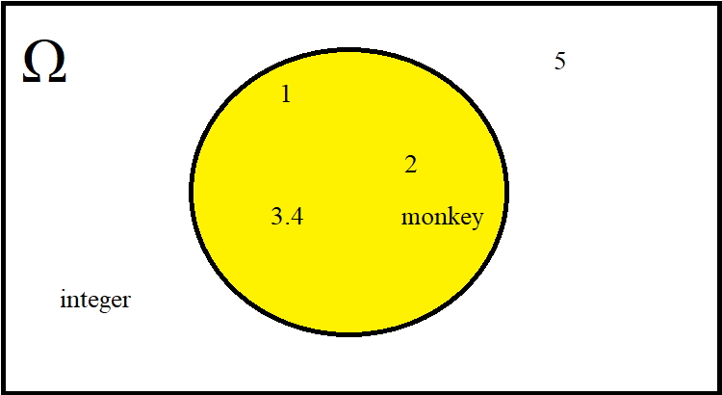
𝜋

Slide 6
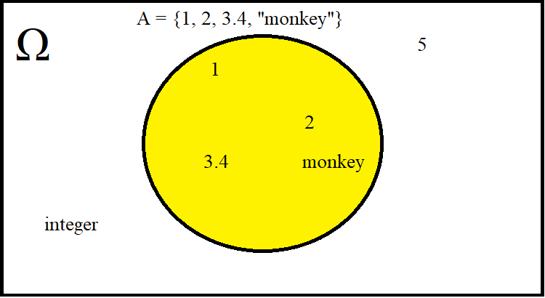
𝜋

Slide 7
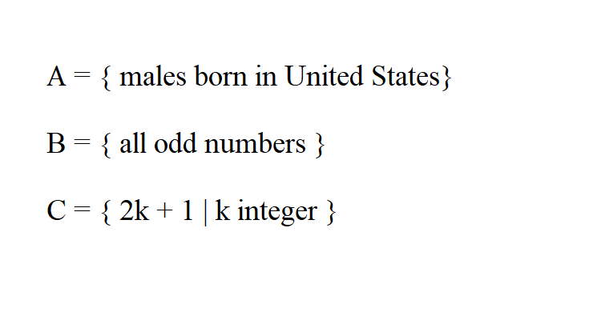

Slide 8
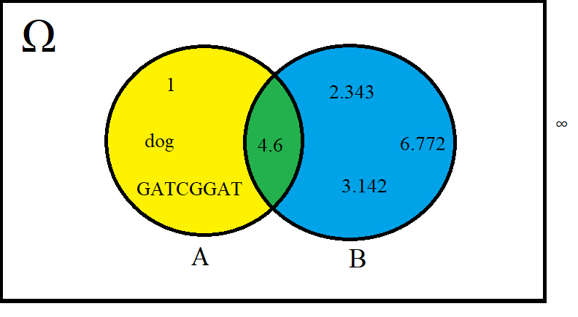

Slide 9
A
B
A∪B
A∩B
A-B
B-A
A x B
{ 1, “dog”, 4.6, GATCGGAT}
{2.343, 6.772, 3.142, 4.6}
{ 1, “dog”, GATCGGAT, 2.343, 6.772, 3.142, 4.6}
{ 4.6 }
{ 1, “dog”, GATCGGAT}
{2.343, 6.772, 3.142}
E.g. {(1, 2.343), (“dog”,2.343),...(4.6,4.6),...}

Slide 10
Symbol | Meaning | Example
Ω | Universe (everything you care about) | Ω = { 0, 1, 2, 3, 4, 5, 6 }
∅ | Empty Set (set of all unicorns that eat pizza) | ∅
{ } | Defines a set | A = { 1, 2, 3, 5 } B = { 0 , 1 }
∈ | Element of a set | 1 ∈ A
∉ | Not an element of a set | 0 ∉ A
|A| | Cardinality of A (number of elements in A) | |A| = 4 |B| = 2

Slide 11
Symbol | Meaning | Example
Ā or A^{C} or A’ | Complement of a set (all items in Ω not in A) | A = { 1, 2, 3, 5 } B = { 0, 1 } Ω = { 0, 1, 2, 3, 4, 5, 6 } A^{C} = { 0, 4, 6 }
∪ (or +) | Union (OR) of two sets | A ∪ B = { 1, 2, 3, 5, 0 }
∩ | Intersection (AND) of two sets | A ∩ B = { 1 }
A x B | Cross Product of A and B (tuples made of one element of A and one element of B) | (1, 1), (3, 0),...
- or \ | Difference of sets (all elements in A not in B) | A - B = A \ B = { 2, 3, 5 }

Slide 12
Subsets
Number of Elements | Subsets of A
0 | ∅
1 | {1}, {2}, {3}, {5}
2 | {1,2}, {1,3}, {1,5}, {2,3}, {2,5}, {3,5}
3 | {1,2,3}, {1,2,5}, {2,3,5}
4 | {1,2,3,5}
A = { 1, 2, 3, 5 }

Slide 13
Power Set of A
A = { 1, 2, 3, 5 }
2^{A} = { ∅, {1}, {2}, {3}, {5}, {1,2}, {1,3}, {1,5}, {2,3}, {2,5}, {3,5}, {1,2,3}, {1,2,5}, {2,3,5}, {1,2,3,5} }

Slide 14
|A ∪ B| = |A| + |B| - |A ∩ B|

Slide 15
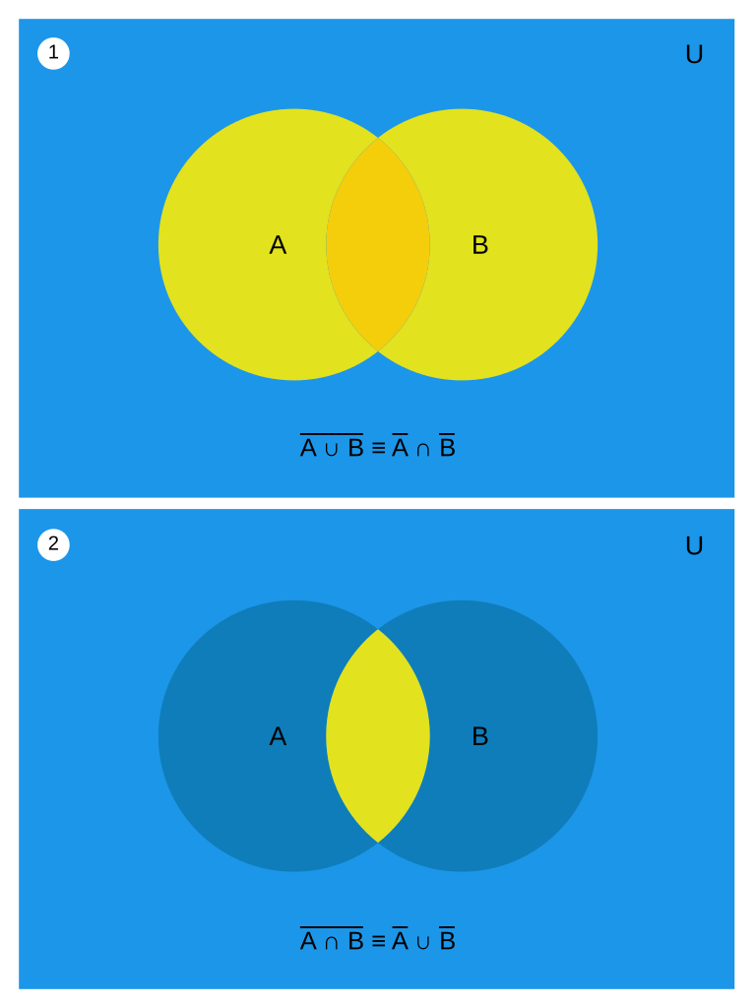
(A ∪ B)^{C} = A^{C} ∩ B^{C}

Slide 16
(A ∩ B)^{C} = A^{C} ∪ B^{C}

Slide 17
Set Laws
DeMorgan’s Laws
(A ∪ B)^{C} = A^{C} ∩ B^{C}
(A ∩ B)^{C} = A^{C} ∪ B^{C}

Slide 18
A
B
A∪B
A∩B
A-B
B-A
A x B
A’
|A|
(A∩B) - { 4.6 }
{ 1, “dog”, 4.6, GATCGGAT}
{2.343, 6.772, 3.142, 4.6}
{ 1, “dog”, GATCGGAT, 2.343, 6.772, 3.142, 4.6}
{ 4.6 }
{ 1, “dog”, GATCGGAT}
{2.343, 6.772, 3.142}
E.g. {(1, 2.343), (“dog”,2.343),...(4.6,4.6),...}
{ 2.343, 6.772, 3.142 }
4
∅

Slide 19
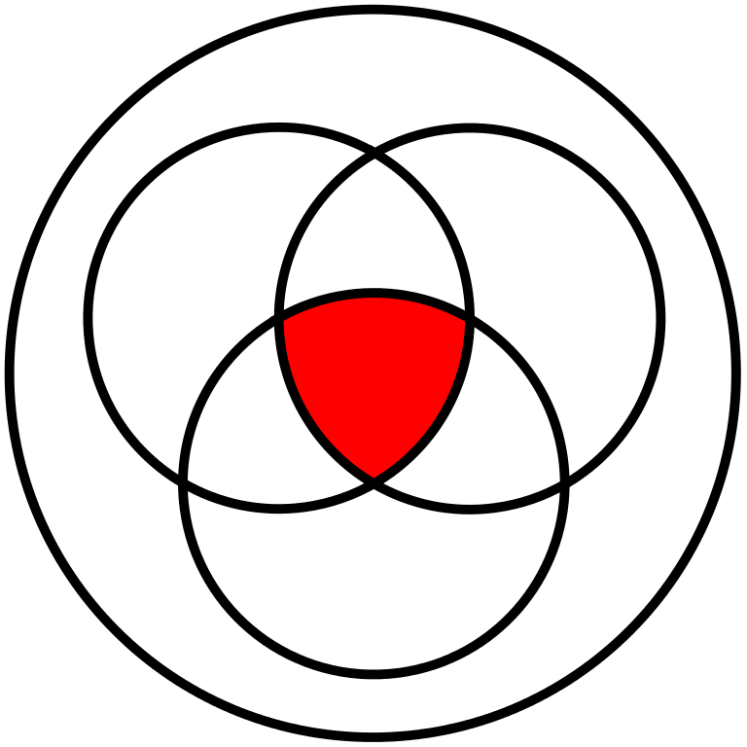
Sets

Slide 20
Graphics
https://www.pexels.com/photo/crowd-crowd-of-people-event-fans-159709/
https://commons.wikimedia.org/wiki/File:1930_census_Olsen_Schmidt.gif
https://pixabay.com/en/blonde-cartoon-character-colorful-1297289/
https://so.wikipedia.org/wiki/File:Flag_of_Canada.svg
https://pixabay.com/en/usa-usa-flag-united-states-1960922/
https://pixabay.com/en/emoticon-yellow-cute-face-emotion-2643816/
https://en.wikipedia.org/wiki/File:Venn_0000_0001.svg
https://en.wikipedia.org/wiki/File:Demorganlaws.svg

